Slide 1










*
UNITED FRONT ELECTION
Prepared by
Mallika Datta Lecturer at EDS
*United International University

Slide 2




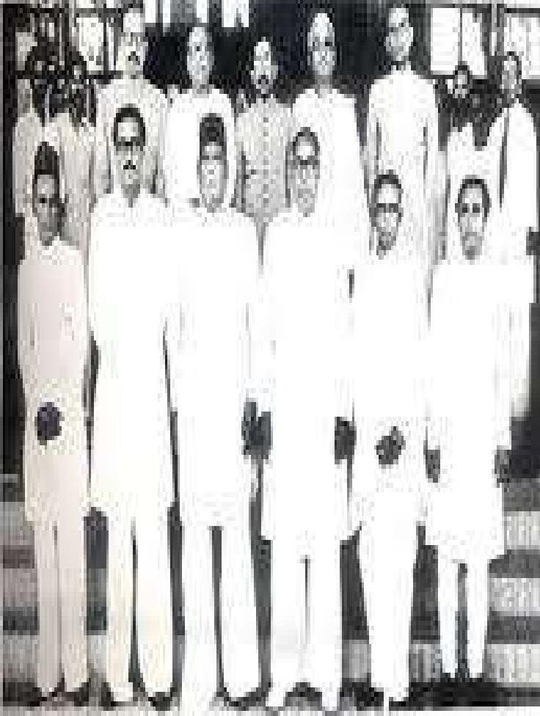
*
Introduction
Alliance of United front.
Twenty-One Point Program.
Result The Election In 1954.
Importance of Election in 1954.
Rise of United Front in1954 Election.
Fall of Muslim League Election in 1954

Slide 3



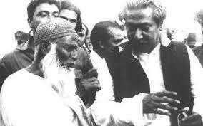
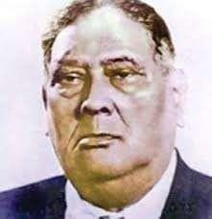
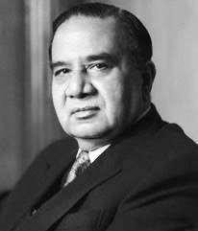
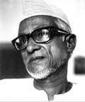
*

Slide 4


Formation Of Awami Muslim League
The Awami League was founded in Rose Garden of KM Das Lane, Dhaka on 23 June 1949.
Founded by A faction of the Bengal Provincial Muslim League headed
by HUSEYN SHAHEED SUHRAWARDY
and ABUL HASHIM.

Slide 5
Leaders
It was established with
Maulana
ABDUL
HAMID
KHAN
BHASANI as president
Shamsul Hoque secretary
as general
Sheikh Mujibur Rahman (then interned in jail), Khondakar Mostaq Ahmed and AK Rafiqul Hussain as joint secretaries

Slide 6

Awami Muslim League to Awami League
As a mark of its secular posture, the term 'Muslim' was deleted from the name of the party at its third council meeting held on 21-23 October 1955.

Slide 7























□
Election in 1954
1954 under the India Act of 1935. The contesting parties in the elections were the ruling Muslim League and a four - party alliance called United Front (Juktofront).

Slide 8










*
AWAMI MUSLIM LEAGUE(Maulana Abdul Hamid Khan Bhasani)
2.Krishak SramikParty,(A.K.F. Haqe)
3Nizam-e-Islam,(Mawlana
Ali)
4 Ganatantri Dal.(HaziDanesh)
Athar

Slide 9









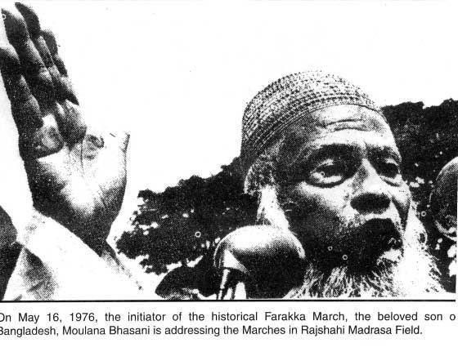
*

Slide 10
Background of the United Front:
Muslim League was the oldest and largest party among the political parties in Bengal before the election of 1954. Besides, Muslim League was leading the provincial government of east Bengal. As a result, the newly formed parties in the east Pakistan planned to form coalition as a strategy to defeat Muslim League in the election in 1954. Resultantly, the decision to form United Front Coalition was taken at the council of Awami Muslim League in Mymensing on 14th November, 1953. The coalition consisted of four main opposition parties; Awami Muslim League led by Maulana Abdul Hamid Khan Bhashani, Krishak-Praja Party led by A K Fazlul Haque, Nezam-E-Islami of Maulana Atahar Ali and the leftist Democratic Party of Hazi Danesh. The electoral symbol for the United Front Coalition was 'Boat'.

Slide 11





Slide 12










*
□The United Front campaigned on an election manifesto consisting of 21 point. This point contains the agriculture, industries and socio-economic development of East Bengal.

Slide 13
21 points
21-Points Charter of United Front:
To Establish Bengali as one of the state language of Pakistan
To dissolute the Zamidari System without compensation and distribute the surplus land among the landless people
To nationalize the Jute Industry.
To establish co-operative agricultural system to develop agriculture.
To set up salt factory
To generate employment for the mohazer-artist-technician class.
To eradicate flood and famine through digging canal and arranging irrigation. Language Movements and Afterwards Political Episode 139
To make the country self dependent on food and industry
To introduce free and mandatory primary education.
Education through mother language, reduce the gap between government and private schools and providing government assistance favoring every school.
To convert the University of Dhaka and Rajshahi University as autonomous body. 12. To reduce the administrative expenses. Ministers salary no to be more than Taka one thousand.
To reduce the administrative expenses. Ministers salary no to be more than Taka one thousand.

Slide 14
21 points
13. To take necessary steps to control bribery, corruption and nepotism.
14. To cancel the dark laws including Public Protection Act and Ordnance.
15.To separate the Judicial Department from the Administrative Department.
16. To make the chief minister's residence 'the Bardhawan House' as Bengali Language Research Center.
17. To construct a monument commemorating the martyrs of 52's language movement.
18. To declare 21 February as government holiday considering it as Shahid Dibosh. 19. To provide full autonomy to East Bengal as per 1940-Lahore Resolution.
20. In no way the validity of Legislative Assembly is extended.
21. If any seats in the Legislative Assembly become vacant, it should be filled in within three months by giving by-election.

Slide 15












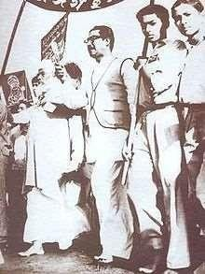
*
CREATE A STRONG ALLIANCE
STRONG LEADING AND POLICY
TWENTY-ONE PROGRAMED OF UNITED FRONT
THE STATEMENT/POSITION OF STATE LANGUAGE

Slide 16
Muslim league’s Campaign
The Muslim Leagues election issues were on religion based. They said that if Pakistan were destroy then Muslim would destroy.

Slide 17
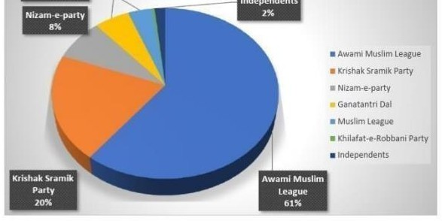
Result
The elections
resulted in a landslide
victory for the United Front which won
228 among 309 seats reserved seats for women)
(including 9

Slide 18
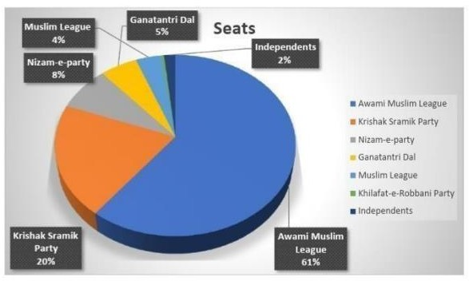
Result
Muslim League won 9 seat, Khalafat Rabbani won only 2 seat and non party won 12 seats.

Slide 19
Reasons of Defeat of Muslim League
1. Formation of United Front and
widespread support in East Pakistan
Failure to formulate the constitution of the Muslim League
Lack of competent leadership
Mass isolation of the Muslim League
Conflict of the Muslim League
Central policy towards East Bengal, lack of tolerance, injustice and exploitation policy
Corruption and nepotism

Slide 20
Formation Of Government
A full cabinet of 14 people was however established in May.
On 15 May 1954, the Awami Muslim League joined the cabinet and Sheikh Mujibur Rahman was appointed Minister of Agriculture, Cooperatives and Rural Development.

Slide 21
Significance
Significance OF United Front Election-
Political Consciousness
The win of the united front demand rises to the full autonomy in this province and it also main agenda of united front.

Slide 22
Significance
Focused on Bengal’s interest
Politics took on a new dimension as a result of party coalitions formed in East Bengal's best interests.

Slide 23
Significance Participation of middle class
It could be marked as the time period where middle class participation in Bengal Politics began.
The influence of well-educated elite groups, including attorneys, journalists, teachers, and businessmen, rose with a university education. Many of the people that were chosen were young.

Slide 24
Significance Preparation for Independence movement
From Juktofront election to the election of 1970 have consists the actual preparation to the freedom of Bangladesh.

Slide 25
Central intervention and United Front cabinet abolished
Juktofront cabinet lasted for only few weeks and on 29th May 1954, it was dismissed by the central government. The reason was the riot in Adamjee jute mill and Chandragona paper mill show that government could not maintain law and order.

Slide 26
The Pakistani government started arrests of United Front activists.
Former Chief Minister Fazlul Haque was placed under house arrest
mass
Aftermath
Maulana Bhasani was banned from entering
the country
Many young leaders including Sheikh Mujib were arrested and United Front offices were
locked.

Slide 27






*
□ 24 October
1954 Pak general
Golam Mohammed departs of Mass Assemble and declare emergency. He formed a ministry with Ayub Khan, Iskandar Mirza, khan shaeb and later Sharawardy as law ministry.

Slide 28







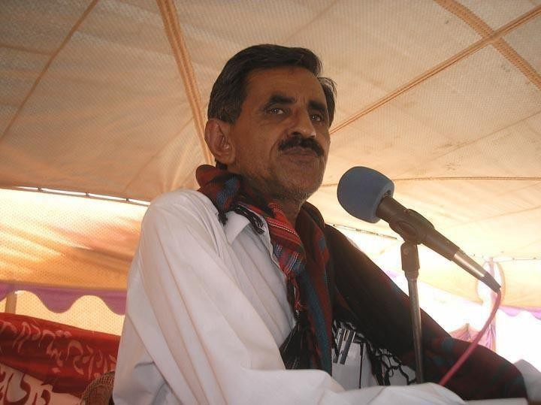
*

Slide 29


THANK YOU

